Slide 1
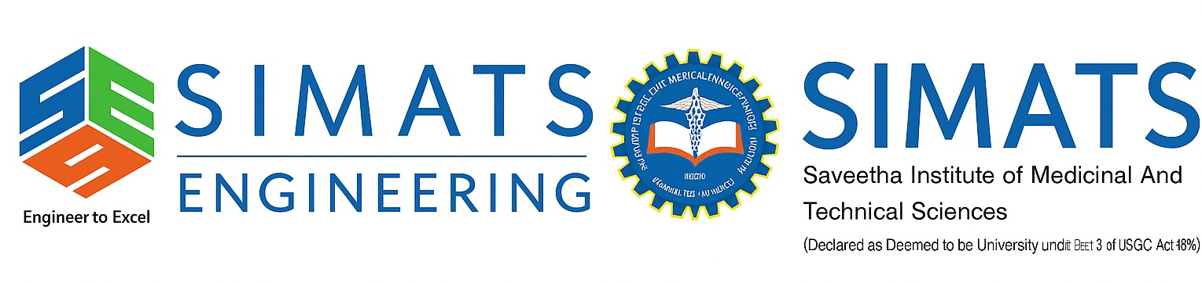
PRIORITY QUEUE DATA STRUCTURE IN TASK SCHEDULING SYSTEM
CSA0313 – DATA STRUCTURES
Presented by: NIVEDHITHA.G(192521231)

Slide 2
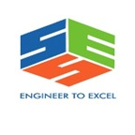

INTRODUCTION
A Priority Queue is a special type of data structure.
It stores tasks based on their priority level instead of the order they arrive.
Tasks with higher priority are executed before lower-priority tasks.
Priority Queues are widely used in CPU scheduling, operating systems, and job management systems.

Slide 3
PROBLEM STATEMENT
Task Scheduling Scenario
In a computer system:
Multiple jobs are submitted by users.
Each job is assigned a priority level (High, Medium, Low).
High-priority jobs must execute before low-priority jobs.
New jobs can arrive at any time.
Challenge
How can the system execute the highest-priority job quickly and efficiently while maintaining good performance?

Slide 4
WHY PRIORITY QUEUE IS SUITABLE?
Priority Queue is the best data structure because:
Executes the highest-priority task first.
Reduces waiting time for critical jobs.
Efficiently manages multiple tasks.
Supports dynamic insertion of new jobs.
Improves overall system performance.

Slide 5
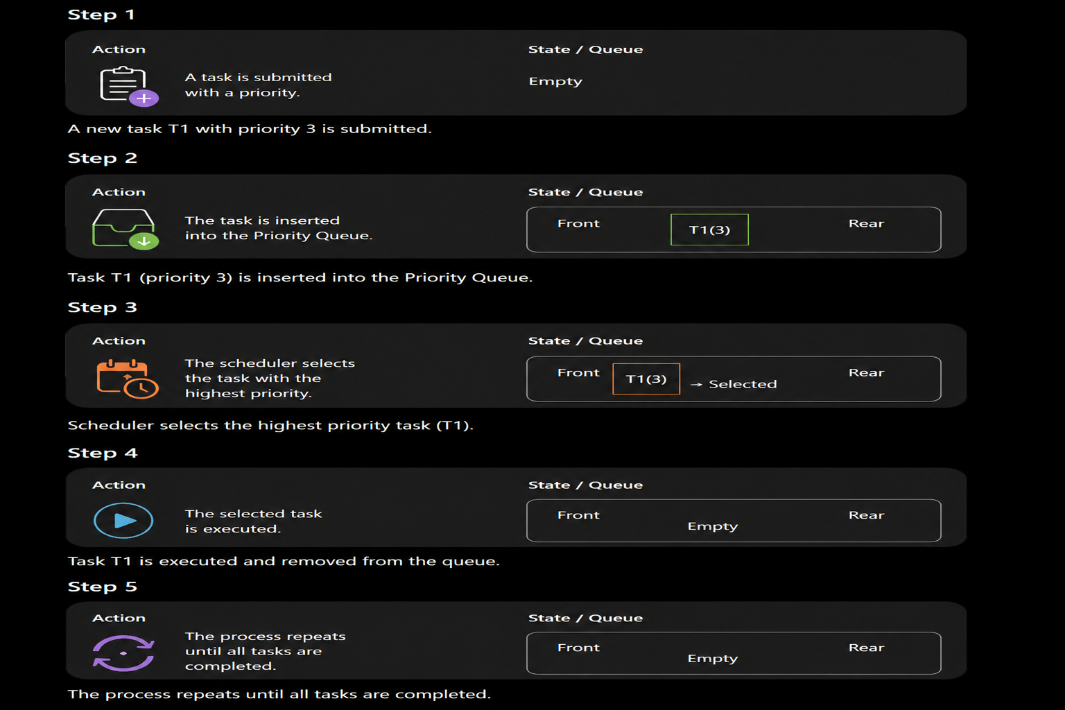
WORKING OF PRIORITY QUEUE

Slide 6
ALGORITHM
Insert (New Task)
Receive a new task.
Assign its priority.
Insert it into the Priority Queue.
Rearrange based on priority.
Execute Task
Select the highest-priority task.
Remove it from the queue.
Execute the task.
Repeat until the queue becomes empty.
TIME COMPLEXITY
Using a Binary Heap implementation:
Insert → O(log n)
Delete Highest Priority → O(log n)
Peek Highest Priority → O(1)

Slide 7
ADVANTAGES
Executes important tasks first.
Improves CPU utilization.
Faster scheduling of urgent jobs.
Efficient for real-time applications.
Handles dynamic task arrivals.

Slide 8
APPLICATIONS
CPU Process Scheduling
Operating Systems
Printer Job Scheduling
Network Packet Scheduling
Hospital Emergency Systems
Airline Flight Scheduling
Cloud Computing Task Management

Slide 9
CONCLUSION
Priority Queue is the most suitable data structure for a Task Scheduling System.
It always executes the highest-priority task first, ensuring efficient resource utilization and reduced waiting time for critical jobs.
Its operations are fast and efficient, making it ideal for operating systems, cloud computing, and real-time scheduling applications.

